Slide 1
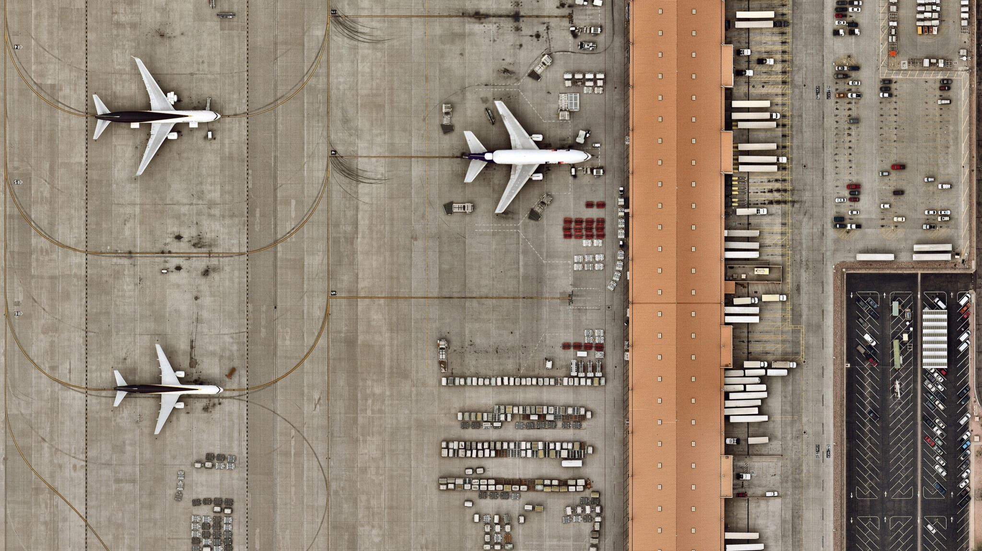

Flight Management System
Josh Snider
Andrew
Daur
Matthew
Lavin
Initial System Requirements

Slide 2

Table of Contents
Problem Definition
Increased Demand
Airline Daily Challenges
System Scope
Object Flow Diagram
Information Topology Chart
Expected Benefits
Storage Requirements
Entity Relationship Diagram
Anticipated Outputs
Feasibility Analysis
Initial Project Schedule

Slide 3

Problem Definition
Significant challenges to airlines due to changes in consumer demand & staffing
Efficient processes must be maintained across several connected systems in a high-hazard environment
Public demand for status of these processes, anger at delayed flights

Slide 4
Increased Demand
Airline demand continues to increase as the years go by, while airport size and employee numbers are limited. How to get more out of the same resources?

Slide 5
Airline Daily Challenges
Managing incoming & outgoing flights through integration with a modern software system
Increase revenue by increasing efficiency and throughput
Minimize lost time for arriving and departing passengers, maximizing customer satisfaction

Slide 6
Proposed Solution
Develop an integrated Flight Management System (FMS)
Streamline workflow for data entry & making decisions from data
Guarantee up-to-date, relevant data for management & customers
Allow communication & cooperation with in-network airports

Slide 7
System Scope
Relational database system to store data of all subsystems
Arrival/Departure Subsystem (ADS) to collate data of all scheduled arrivals and departures as well as delays and cancellations
Port Information Subsystem (PIS) to retrieve and organize information on airports, terminals, runways, and gates
Aircraft & Airline Subsystem (AAS) to process information regarding participating airlines and their aircraft, as well as flight routes and flight crew

Slide 8
Object Flow Diagram
Relational Database
Port Information Subsystem
Arrival/Departure Subsystem
Aircraft & Airline Subsystem

Slide 9
Information Topology Chart
Flight Management System
Aircraft & Airline Subsystem
Airport
Aircraft
Aircraft Category
Airline
Terminal
Gate
Runway
Country
Port Information Subsystem
Arrival/Departure Subsystem
Flight Crew
Flight Crew
Flights
Flight Schedules

Slide 10
Expected Benefits
Accurate, up-to-date, easily accessible records on all aspects of airport logistics
Easier, more efficient flight scheduling, better utilization of runways
Elimination of errors in flight crew schedules
Streamlining of all business processes, simplified data entry and decision-making
Increased revenue flow and profit margins with a smarter system
Notes:
Handoff after

Slide 11
Storage Requirements
[E01] Countries
[E02] Airports
[E03] Airlines
[E04] Aircraft
[E05] Runways
[E06] Terminals
[E07] Gates
[E08] Flight crew
[E09] Flights
[E10] Flight schedule
[E11] Aircraft types

Slide 12
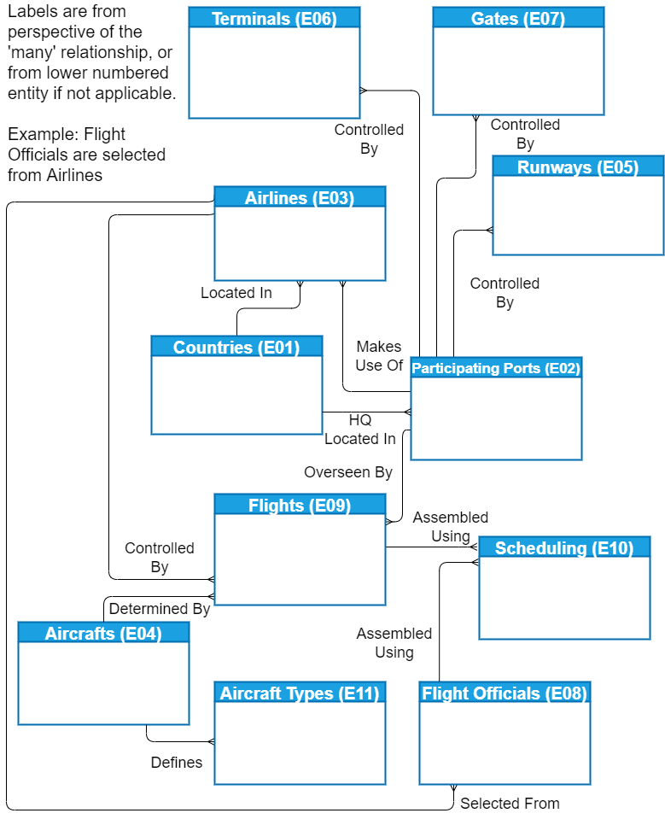
Entity Relationship Diagram (ERD)

Slide 13
Anticipated Outputs
Arrival Log
Departure Log
Schedule Board : for flight arrival and departure
Flight Status Report : delays / cancellations
Flight Crew Schedule and Log
Terminal and Gate Status Report
Connected Airlines Contact Report

Slide 14
Feasibility Alternatives
Alternative – A
Minimal computer hardware useage, recording information on paper. Cost efficient and training would be minimal, yet rudimentary and inefficient.
Alternative – B
Purchasing an existing computer and network infrastructure, mend to our specific needs. Costly, but low development time.
Alternative – C
Developing our own environment and integrating it into an existing infrastructure. Longer development time but basically free. We are the ones providing the labor.

Slide 15
Feasibility Analysis
Alternative C being the most feasible option.
Feasibility factor | Alt-A | Alt-B | Alt-C
Technical feasibility [Max 80] | 58 | 72 | 75
Economic feasibility [Max 140] | 97 | 115 | 124
Operational feasibility [Max 60] | 53 | 58 | 57
Software quality [Max 220] | 149 | 202 | 213
Overall evaluation [Max 500] | 357 | 447 | 469

Slide 16
Initial Project Schedule
Activity # | Activity Description | Weeks
1 | Initial System Requirement | 1
2 | Requirements Specification | 2
3 | Design Specification | 3
4 | Database Creation | 3
5 | Prototype Development | 10
6 | Software Documentation | 3
7 | Software Install & Delivery | 2
 | Total duration | 24

